Slide 1
Big Data Frameworks
Ramesh Ragala
VIT Chennai

Slide 2
Hadoop I/O
Data Integrity:
No data will be lost or corrupt during storage or processing
Possibility of errors (I/O operation, data transferring in network)
How to Identify the corrupted Data:
Error Detection Mechanisms
Error Correction Mechanisms
Error Detection Mechanism:
Checksum
Checksum is computed for the data when it first enters the system and again whenever it is transmitted across a channel.
What happens if the check sum is corrupted not data → this case is rare, because the checksum is smaller than the data
The Common type of Checksum used in hadoop is CRC-32 (ChecksumFileSystem )[CRC-32C]
CRC-32C checksum is 4 bytes long → the storage overhead is less than 1%
22 October 2019
<number>

Slide 3
Hadoop I/O
Datanodes are responsible for verifying the data they receive before storing the data and its checksum.
When clients read data from datanodes, they verify checksums as well, comparing them with the ones stored at the datanodes.
Each datanode keeps a persistent log of checksum verifications, so it knows the last time each of its block was verified.
When the client verifies a block, it tells the datanode, which updates its log. → helps to identify the bad disks
DataBlockScanner thread runs periodically at background.
Can we solve bad blocks through replica?????
22 October 2019
<number>

Slide 4
Hadoop I/O
DataBlockScanner thread runs periodically at background.
This allows bad blocks to be detected and fixed before they are read by clients
The scanner maintains a list of blocks to verify and scans them one by one for checksum errors
It employs a throttling mechanism to preserve disk bandwidth on the datanode.
Blocks are verified every three weeks to guard against disk errors over time.
Corrupt blocks are reported to the namenode to be fixed.
http://datanode:50075/blockScannerReport --> to get a block verification report of a datanode
It is possible to disable verification of checksums by passing false to the setVerify Checksum() method on FileSystem before using the open() method to read a file
22 October 2019
<number>

Slide 5
Hadoop I/O
Can we solve bad blocks through replica?????
YES
Because HDFS stores replicas of blocks, it can “heal” corrupted blocks by copying one of the good replicas to produce a new, uncorrupt replica
The way this works is that if a client detects an error when reading a block, it reports the bad block and the datanode it was trying to read from to the namenode before throwing a ChecksumException.
The namenode marks the block replica as corrupt so it doesn’t direct any more clients to it or try to copy this replica to another datanode.
It then schedules a copy of the block to be replicated on another datanode, so its replication factor is back at the expected level.
Once this has happened, the corrupt replica is deleted.
22 October 2019
<number>

Slide 6
Hadoop I/O
LocalFileSystem:
The Hadoop LocalFileSystem performs client-side checksumming.
This means that when you write a file called filename, the filesystem client transparently creates a hidden file, .filename.crc, in the same directory containing the checksums for each chunk of the file.
The chunk size is controlled by the file.bytes-per-checksum property, which defaults to 512 bytes.
The chunk size is stored as metadata in the .crc file, so the file can be read back correctly even if the setting for the chunk size has changed.
Checksums are verified when the file is read, and if an error is detected, LocalFileSystem throws a ChecksumException.
Checksums are fairly cheap to compute (in java)
RawLocalFileSystem: disable checksum, when it is done underlying filesystem natively.
22 October 2019
<number>

Slide 7
Hadoop I/O
ChecksumFileSystem:
LocalFileSystem uses ChecksumFileSystem to do its work, and this class makes it easy to add checksumming to other filesystems, as Checksum FileSystem is just a wrapper around FileSystem.
getChecksumFile() → getting the path of a checksum file for any file.
If an error is detected by ChecksumFileSystem when reading a file, it will call its reportChecksumFailure() method.
The default implementation does nothing, but LocalFileSystem moves the offending file and its checksum to a side directory on the same device called bad_files.
Administrators should periodically check for these bad files and take action on them.
22 October 2019
<number>

Slide 8
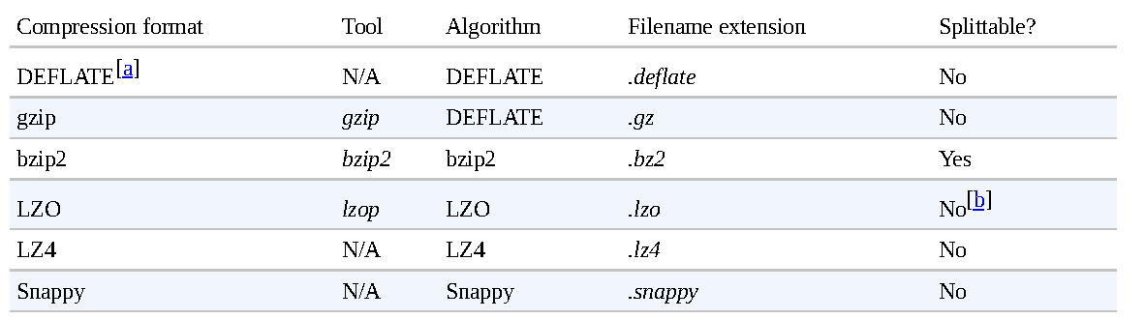
Hadoop I/O
Compression:
It reduces the space needed to store files
It speeds up data transfer across network or from disk
Faster compression and decompression speeds usually comes at the expense of smaller space savings
22 October 2019
<number>

Slide 9
Hadoop I/O
Data Compressions
All compression algorithms exhibit a space/time trade-off.
Different options: –1 means optimize for speed, and -9 means optimize for space.
gzip has good performance in compression and space/time trade-off
bzip2 compress more effectively than gzip, but slower.
bzip2 has fast decompress rather than compression.
LZO, LZ4, and Snappy, all optimize for speed and are around an order of magnitude faster than gzip, but compress less effectively.
Snappy and LZ4 are also significantly faster than LZO for decompression
22 October 2019
<number>

Slide 10
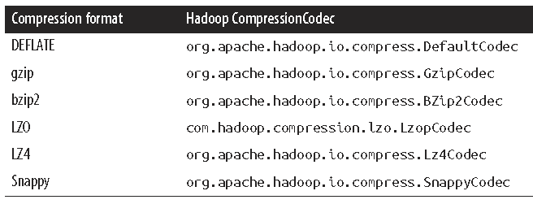
Hadoop I/O
Data Compressions
A codec is the implementation of a compression-decompression algorithm
CompressionCodec interface is used in hadoop .
GzipCodec encapsulates the compression and decompression algorithm for gzip.
22 October 2019
<number>

Slide 11
Hadoop I/O
Data Compressions
The LZO libraries are GPL licensed and may not be included in Apache distributions, so for this reason the Hadoop codecs must be downloaded separately from Google
CompressionCodec has two methods that allow you to easily compress or decompress data.
To compress data being written to an output stream, use the createOutput Stream(OutputStream out) method to create a CompressionOutputStream to which you write your uncompressed data to have it written in compressed form to the underlying stream.
To decompress data being read from an input stream, call createInputStream(InputStream in) to obtain a CompressionInputStream, which allows you to read uncompressed data from the underlying stream.
22 October 2019
<number>

Slide 12
Hadoop I/O
Data Compressions
If you are reading a compressed file, normally you can infer which codec to use by looking at its filename extension.
Example: A file ending in .gz can be read with GzipCodec.
CompressionCodecFactory provides a way of mapping a filename extension to a CompressionCodec using its getCodec() method.
Each codec knows its default filename extension, thus permitting CompressionCodecFactory to search through the registered codecs to find a match for the given extension.
22 October 2019
<number>

Slide 13
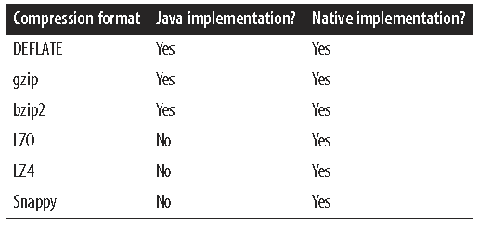
Hadoop I/O
Data Compressions
It is preferable to use a native library for compression and decompression for performance sake.
Example: in one test, using the native gzip libraries reduced decompression times by up to 50% and compression times by around 10%.
All formats have native implementations, but not all have a Java implementation
The Apache Hadoop binary tarball comes with prebuilt native compression binaries for 64-bit Linux, called libhadoop.so.
22 October 2019
<number>

Slide 14
Hadoop I/O
Data Compressions
If you are using a native library and you are doing a lot of compression or decompression in your application, consider using CodecPool, which allows you to reuse compressors and decompressors, thereby amortizing the cost of creating these objects.
22 October 2019
<number>

Slide 15
Hadoop I/O
USE CASE
How to compress data that will processed by MapReduce
Is the compression format supports splitting?
Assume Dataset size is 1GB
Assume HDFS block size is 128MB → 8 blocks
Imagine that the file is a gzip-compressed file whose compressed size is 1 GB
Creating a split for each block won’t work, because it is impossible to start reading at an arbitrary point in the gzip stream.
Impossible for a map task its split independently of the others.
The gzip format uses DEFLATE to store the compressed data and DEFLATE stores data as a series of compressed blocks.
The problem is that the start of each block is not distinguished in any way would allow a reader positioned at an arbitrary point → Synchronizing problem.
So gzip is not support for splitting
Mapreduce will not try to split the gzipped file → expensive of locality (single map will process 8 blocks and most of the blocks will not be local to the map)
22 October 2019
<number>

Slide 16
Hadoop I/O
USE CASE
How to compress data that will processed by MapReduce
Assume the file is a LZO file. → same problem
The compression format does not provide a way for a reader to synchronize itself with the stream.
pre-processing LZO files using an indexer tool. The tool builds an index of split points, effectively making them splittable when the appropriate MapReduce input format is used.
A bzip2 file supports
22 October 2019
<number>

Slide 17
Hadoop I/O
Which Compression Format Should Use?
Hadoop applications process large datasets, so you should strive to take advantage of compression
Which compression format you use depends on such considerations as file size, format, and the tools you are using for processing.
suggestions, arranged roughly in order of most to least effective:
Use a container file format such as sequence files, Avro datafiles, ORCFiles, or Parquet files , all of which support both compression and splitting. A fast compressor such as LZO, LZ4, or Snappy is generally a good choice.
Use a compression format that supports splitting, such as bzip2 (although bzip2 is fairly slow), or one that can be indexed to support splitting, such as LZO.
Split the file into chunks in the application, and compress each chunk separately using any supported compression format. In this case, you should choose the chunk size so that the compressed chunks are approximately the size of an HDFS block
Store the files uncompressed.
22 October 2019
<number>

Slide 18
Hadoop I/O
Serialization:
Process of turning structured object into a byte stream for transmission over a network or for writing to persistent storage.
Process of turning a byte stream back into a series of structured objects → Deserialization.
For Inter-Process Communication : RPC is used in Hadoop for IPC
For persistent storage
The RPC uses Serialization → renders message into byte stream → sent to remote node → deserialization @ remote node
RPC Serialization Format should be:
Compact
Best use of network bandwidth
Fast
Little performance overhead
Extensible
Protocols change over time to meet new requirements
Interoperable
Different languages ( client & server)
22 October 2019
<number>

Slide 19
Hadoop I/O
The data format chosen for persistent storage would have different requirements from a serialization framework.
Hadoop uses its own serialization format, Writables.
It is compact and fast, but not so easy to extend or use from languages other than Java
Writables are central to Hadoop
MapReduce programs use them for their key and value types
Writable Interface: it has two methods
Writing its state to DataOutput binary stream
Void write(DataOutput out)
Reading its state from a DataInput binary stream
Void readFields(DataInput in)
22 October 2019
<number>

Slide 20
Hadoop I/O
Set() and get() method are used to set and get the values to writables classes.
Example: IntWritable one = new IntWritable()
one.set(26)
Big-endian order is used.
Comparison of types is crucial for MapReduce, where there is a sorting phase during which keys are compared with one another.
IntWritable implements the WritableComparable interface, which is just a subinterface of the Writable and java.lang.Comparable interfaces
RawComparator is also used by hadoop → This interface permits implementors to compare records read from a stream without deserializing them into objects, thereby avoiding any overhead of object creation
22 October 2019
<number>

Slide 21
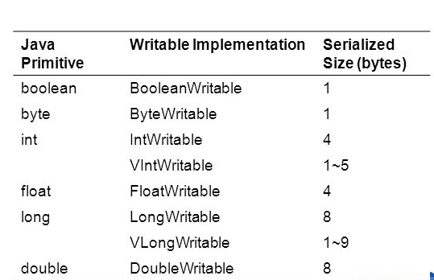
Hadoop I/O
Hadoop comes with a large selection of Writable classes, which are available in the org.apache.hadoop.io package.
There are Writable wrappers for all the Java primitive types
fixed-length Vs variable-length encoding
Fixed-length: when the distribution of values are
Fairly uniform.
Variable-length: non-uniform distribution
Text:
Text is a Writable for UTF-8 sequences.
It is writable equivalent of java.lang.String
It uses an Int to store number of bytes in encoding
22 October 2019
<number>

Slide 22
Hadoop I/O
BytesWritable:
BytesWritable is a wrapper for an array of binary data
Its serialized format is a 4-byte integer field that specifies the number of bytes to follow, followed by the bytes themselves.
For example, the byte array of length 2 with values 3 and 5 is serialized as a 4-byte integer (00000002) followed by the two bytes from the array (03 and 05):
BytesWritable is mutable, and its value may be changed by calling its set() method.
NullWritable:
NullWritable is a special type of Writable, as it has a zero-length serialization.
No bytes are written to or read from the stream.
It is used as a placeholder
22 October 2019
<number>

Slide 23
Hadoop I/O
ObjectWritable and GenericWritable:
These are general-purpose wrapper for Java primitives, String, enum, Writable, null, or arrays of any of these types.
It is used in Hadoop RPC to marshal and unmarshal method arguments and return types.
ObjectWritable is useful when a field can be of more than one type
Writable collections:
The org.apache.hadoop.io package includes six Writable collection types:
ArrayWritable
ArrayPrimitiveWritable
TwoDArrayWritable
MapWritable
SortedMapWritable
EnumSetWritable
22 October 2019
<number>

Slide 24
Hadoop I/O
Implementing custom Writable:
With a custom Writable, you have full control over the binary representation and the sort order.
CLASS
22 October 2019
<number>

Slide 25
Hadoop I/OL: File Based Data Structures
A specialized data structure is needed to hold data for few applications.
Solution - I:
Put each blob of binary data into its own file and apply MapReduce based processing
Limitations:
It does not scale up. → so it developed a number of higher-level containers for these situations.
Scenario:
Imagine a logfile, where each log record is a new line of text. If you want to log binary types, plain text isn’t a suitable format.
Hadoop’s SequenceFile class fits in this situation, providing a persistent data structure for binary key-value pairs.
It also work well as containers for smaller files
22 October 2019
<number>

Slide 26
Hadoop I/OL: File Based Data Structures
One of its createWriter() static methods is used to create SequenceFile. → it returns a SequenceFile.Writer instance.
There are several overloaded versions, but they all requires
specify a stream to write to
a Configuration object
the key and value types
Optional arguments include the compression type and codec, a Progressable callback to be informed of write progress, and a Metadata instance to be stored in the SequenceFile header.
The keys and values stored in a SequenceFile do not necessarily need to be Writable.
Any types that can be serialized and deserialized by a Serialization may be used.
22 October 2019
<number>

Slide 27
Hadoop I/OL: File Based Data Structures
append() method is used to write key-value pairs after having a instance of SequenceFile.Writer.
Simple and abstract way of using SequenceFile format for writing
SequenceFile.Writer writer = null;
writer = SequenceFile.createWriter(fs, conf, path, key.getClass(), value.getClass());
writer.append(key, value);
Example in the text book:: Page No: 128
22 October 2019
<number>

Slide 28
Hadoop I/OL: File Based Data Structures
Reading a sequence File:
It uses instance of SequenceFile.Reader and iterates over the records using next() methods → Which one you use depends on the serialization framework you are using.
If you are using Writable types, you can use the next() method that takes a key and a value argument, and reads the next key and value in the stream into these variables → public boolean next(Writable key, Writable val)
For other, nonWritable serialization frameworks, it use these two methods:
public Object next(Object key) throws IOException
public Object getCurrentValue(Object val) throws IOException
types are discovered from the Sequence File.Reader via calls to getKeyClass() and getValueClass(), then ReflectionUtils is used to create an instance for the key and an instance for the value
22 October 2019
<number>

Slide 29
Hadoop I/OL: File Based Data Structures
Reading a sequence File:
Example in Page No: 130
Another feature of the program is that it displays the position of the sync points in the sequence file.
A sync point is a point in the stream that can be used to resynchronize with a record boundary if the reader is “lost”—for example, after seeking to an arbitrary position in the stream.
Sync points are recorded by SequenceFile.Writer, which inserts a special entry to mark the sync point every few records as a sequence file is being written.
Such entries are small enough to incur only a modest storage overhead—less than 1%.
Sync points always align with record boundaries.
22 October 2019
<number>

Slide 30
Hadoop I/OL: File Based Data Structures
two ways to seek to a given position in a sequence file:
seek(long pos) - positions the reader at the given point in the file.
next() method fails if the pos is not a record boundary.
sync(long pos) - positions the reader at the next sync point after position. we can call sync() with any position in the stream—a non-record boundary, for example—and the reader will reestablish itself at the next sync point so reading can continue.
SequenceFile.Writer has a method called sync() for inserting a sync point at the current position in the stream.
hadoop fs command has a -text option to display sequence files in textual form.
it can attempt to detect the type of the file and appropriately convert it to text.
It can recognize gzipped files and sequence files; other- wise, it assumes the input is plain text.
22 October 2019
<number>

Slide 31
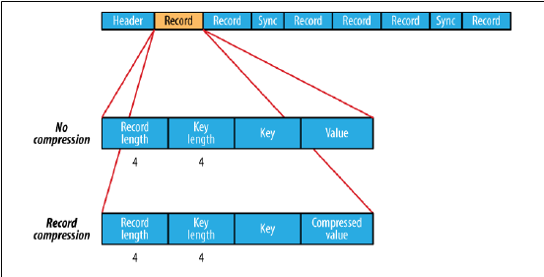
Hadoop I/OL: File Based Data Structures
Sorting and Merging SequenceFiles:
SequenceFile.Sorter class that has a number of sort() and merge() methods, which are used to sort/merge in MapReduce.
The SequenceFile format:
A sequence file consists of a header followed by one or more records.
Sequence files can also be compressed for space considerations and based on these compression type users, Hadoop Sequence files can be of three types:
Uncompressed
Record Compressed
Block Compressed
22 October 2019
<number>

Slide 32
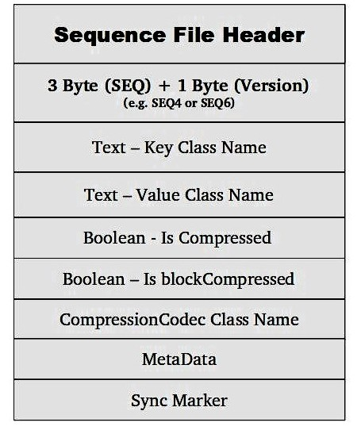
Hadoop I/OL: File Based Data Structures
SequenceFile Header:
Version:
Version of the file is the first data stored in the header.
It consists of a byte array in which first 2 bytes are “SEQ” followed by 1 byte which indicates the version of the file format. For example: SEQ4 or SEQ6
Key Class Name:
Next information is the string which tells the class of the key. For example it can be “Text” class.
Value Class Name:
Another string which mentioned the class of the value type. For example: “Text” class.
Compression:
A boolean value which informs the reader if the file is comptessed or not.
22 October 2019
<number>

Slide 33
Hadoop I/OL: File Based Data Structures
SequenceFile Header:
Block Compression:
Another boolean value which informal if the file is block compressed.
Compression Codec Class:
The classname of the Compression Codec which is used for compressing the data and will be used for de-compressing the data.
MetaData:
Key-value pair which can provide another metadata required for the file.
Sync Marker:
A sync marker which indicates that this is the end of the header
22 October 2019
<number>

Slide 34
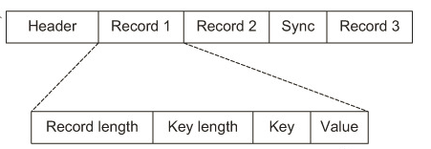
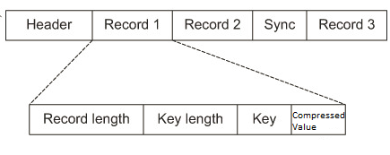
Hadoop I/OL: File Based Data Structures
Uncompressed File Data Format:
Record - compressed File Data Format:
22 October 2019
<number>

Slide 35
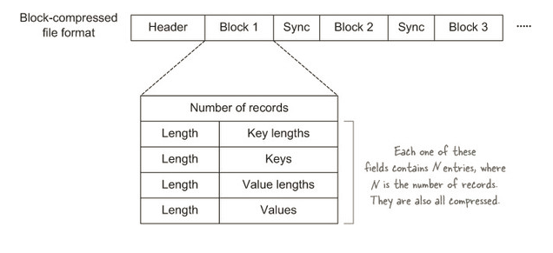
Hadoop I/O: File Based Data Structures
Block compressed File Data Format:
22 October 2019
<number>

Slide 36
Hadoop I/O: File Based Data Structures
MapFile Format:
A MapFile is a sorted SequenceFile with an index to permit lookups by key.
The index is itself a SequenceFile that contains of the keys in the map(every 128th key by default)
The idea is that the index can be loaded into memory to provide fast lookups from the main data file, which is another SequenceFile containing all the map entries in sorted key order.
It also offers similar kind of interface for reading and writing
The main thing to be aware of is that when writing using MapFile.Writer, map entries must be added in order, otherwise IOException will be thrown.
22 October 2019
<number>

Slide 37
Hadoop I/O: File Based Data Structures
MapFile Varients:
Hadoop comes with a few variants on the general key-value MapFile interface:
SetFile is a specialization of MapFile for storing a set of Writable keys. The keys must be added in sorted order
ArrayFile is MapFile where the key is an integer representing the index of element in the array and the value is a Writable value
BloomMapFile is a MapFile that offers a fast version of the get() method, especially for sparsely populated files.
22 October 2019
<number>

Slide 38

22 October 2019
<number>

